Slide 1



fwd initiative
Project-Bike Share Data
Walk-through

Slide 2
Agenda
Project Overview
Code Walkthrough
1
2
3
4
5
Project Details
- Overview
- The Datasets
- Statistics Computed
- The Files
Workspace & Submission
Data loading
get_filter and load_data functions
Statistics Output
4 functions
Interactive Raw Data display
display_raw_data(city)

Slide 3
Agenda
Project Overview
Code Walkthrough
1
2
3
4
5
Project Details
- Overview
- The Datasets
- Statistics Computed
- The Files
Workspace & Submission
Data loading
get_filter and load_data functions
Statistics Output
4 functions
Interactive Raw Data display
display_raw_data(city)

Slide 4
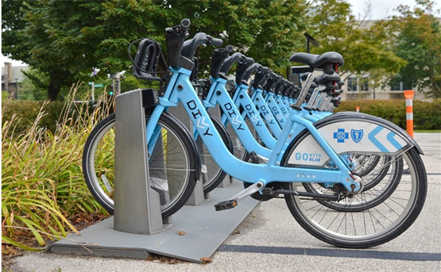

Project overview
The Files:
Inputs:
chicago.csv
new_york_city.csv
Washington.csv
+
Raw input
bikeshare.py
Outputs :
Interactive script displaying statistics and Data upon request

Slide 5
Project Details
The Datasets:
Randomly selected data for the first six months of 2017 are provided for all three cities. All three of the data files contain the same core six (6) columns:
Start Time (e.g., 2017-01-01 00:07:57)
End Time (e.g., 2017-01-01 00:20:53)
Trip Duration (in seconds - e.g., 776)
Start Station (e.g., Broadway & Barry Ave)
End Station (e.g., Sedgwick St & North Ave)
User Type (Subscriber or Customer)
The Chicago and New York City files also have the following two columns:
Gender
Birth Year

Slide 6
Project Details
User Input
User should input three variable
City (there are only three options Chicago, New York City and Washington)
Time Frame input: Would you like to filter the data by month, day, both or not at all?
Month (available options January, February, March, April, May, June )
Day (available options all days are avaiable )
If he want to display random rows of data.
If he want to restart

Slide 7
Project Details
Statistics Computed:
Popular times of travel (i.e., occurs most often in the start time):
most common month
most common day of week
most common hour of day
Popular stations and trip:
most common start station
most common end station
most common trip from start to end (i.e., most frequent combination of start station and end station)
Trip duration:
total travel time
average travel time
User info:
counts of each user type
counts of each gender (only available for NYC and Chicago)
earliest, most recent, most common year of birth (only available for NYC and Chicago)

Slide 8
Project Details
What Software Do I Need to complete this project locally?:
You should have Python 3, NumPy, and pandas installed using Anaconda
A text editor, like Sublime or Atom.
A terminal application

Slide 9
Agenda
Project Overview
Code Walkthrough
1
2
3
4
5
Project Details
- Overview
- The Datasets
- Statistics Computed
- The Files
Workspace & Submission
Data loading
get_filter and load_data functions
Statistics Output
4 functions
Interactive Raw Data display
display_raw_data(city)

Slide 10
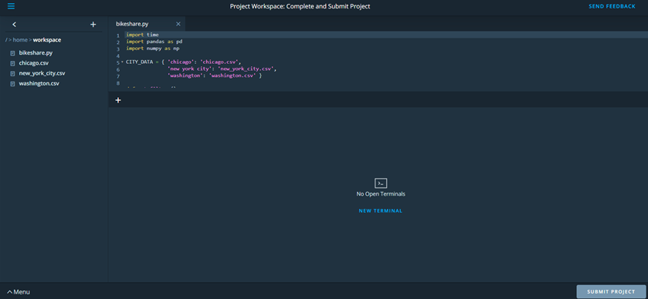
Workspace & Submission

Slide 11
Workspace & Submission
Before You Submit::
Check the Rubric:
Your project will be evaluated by a Udacity reviewer according to this Project Rubric. Be sure to review it thoroughly before you submit. Your project "meets specifications" only if it meets specifications in all the criteria.
Gather Submission Materials:
bikeshare.py: Your code
readme.txt: If you refer to other websites, books, and other resources to help you in solving tasks in the project, make sure that you document them in this file

Slide 12
Agenda
Project Overview
Code Walkthrough
1
2
3
4
5
Project Details
- Overview
- The Datasets
- Statistics Computed
- The Files
Workspace & Submission
Data loading
get_filter and load_data functions
Statistics Output
4 functions
Interactive Raw Data display
display_raw_data(city)

Slide 13
Libraries and Data
Inputs:
Raw input (City - Timeframe - Which month /Which day)
Bikeshare.py
Outputs :
Interactive script that answers questions about the dataset
Script Setting Up:
import time
import pandas as pd
import numpy as np
CITY_DATA = { 'chicago': 'chicago.csv',
'new york city': 'new_york_city.csv',
'washington': 'washington.csv' }
Importing the required libraries at the top of the script as per the best practices.
Assigning a dictionary to map the city names' to the corresponding file name path in the file system to access later within the code.

Slide 14
User Questions
Inputs:
Raw input (City - Timeframe - Which month /Which day)
bikeshare.py
(get_filter())
Outputs :
Interactive script that answers questions about the dataset
There are four questions that user should response:
The City input: Would you like to see data for Chicago, New York, or Washington?
TimeFrame input: Would you like to filter the data by month, day, or not at all?
Month input (If they chose month): Which month - January, February, March, April, May, or June?
Day input (If they chose day): Which day - Monday, Tuesday, Wednesday, Thursday, Friday, Saturday, or Sunday?

Slide 15
Algorithm
def get_filters(df):
month, day == “all”, “all”
cities = list of available cities
months = list of first six months
days = list of all week days
city = get user input
while city not in cities:
city = get a valid input from user
filter = get input if user wants to filter data
if filter == ‘month’ or filter == “all”:
month = get month input
while month not in months:
month = get month input

Slide 16
Algorithm
def get_filters(df):
…………………………….
if filter == “day” or filter ==“all”:
day = get day input
while day not in days:
day = get a valid input
return (city, month, day)
Remember:
Any time you ask users for input, there is a chance they may not enter what you expect, so your code should handle unexpected input well without failing. You need to anticipate raw input errors like:
Using improper upper or lower case
Users misunderstanding what you are expecting.

Slide 17
Interactive Experience
Inputs:
Raw input (City - Timeframe - Which month /Which day)
bikeshare.py
(get_filter())
Outputs :
Interactive script that answers questions about the dataset
Simple Algorithm to get and check input
def get_city_name():
cities = list of available cities
city = get user input
while city not in cities:
city = get a valid input from user
return city

Slide 18

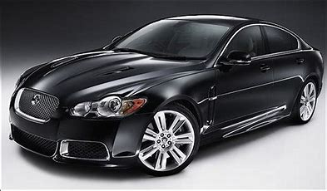
The get_filter() function
Outputs:
Now, you can set the return statement: return(city, month, day)
Don't forget testing your script after you are done writing the get_filters() function. You call it and assign the result to the variable names that will be used as input for the load_data() function like this:
filtered_values = get_filters()
city, month, day = filtered_values
Also Take EXTRA CARE of the INDENTATION

Slide 19
The load_data() Function
Inputs:
City - Month - Day
Bikeshare.py
(Load_data())
Outputs :
Dataframe (df)
The load_data(city, month, day):
Load data that match chosen city name
Convert timestamp column to datetime
Extract month and day name from timestamp column
Filter data depending on user choice of both day and month
This function should return df which is a dataframe.
Don't forget to call and assign a variable df to the output
load_data(city, month, day)
df = load_data(city, month, day)

Slide 20


The First Function
CITY_DATA = { 'chicago': 'chicago.csv',
'new york city': 'new_york_city.csv',
'washington': 'washington.csv' }
get_filters()
Output:
City that matches one in the CITY_DATA dictionary
Month that is a string of the month name or the string “all”
Day that is a string of the day name or the string “all”
Raw User input
City
Day:
Saturday
Sunday
Monday
Tuesday
Wednesday
Thursday
Friday
All
Month:
January
February
March
April
May
June
All
load_data(city, month, day)
Filtered Dataframe
df

Slide 21
Agenda
Project Overview
Code Walkthrough
1
2
3
4
5
Project Details
- Overview
- The Datasets
- Statistics Computed
- The Files
Workspace & Submission
Data loading
get_filter and load_data functions
Statistics Output
4 functions
Interactive Raw Data display
display_raw_data(city)

Slide 22
Statistics Output (Google is your friend)
Inputs:
Data Frame (df)
Bikeshare.py
Time_stats()
Outputs :
Print some statistics
time_stats(df):
Extract hour from timestamp column
Get : (Using value_counts() method)
most common month
most common day of week
most common hour of day
Note
When the user input specifies a particular month (most common month is meaningless)
When the user input specifies a particular day (most common day is meaningless)

Slide 23
Statistics Output (Google is your friend)
Inputs:
Data Frame (df)
Bikeshare.py
trip_duration_stats()
Outputs :
Print statistics
trip_duration_stats(df):
Get : (Using value_counts() method
most common start station
most common end station
most common trip from start to end
Note
most common trip from start to end (i.e., most frequent combination of start station and end station). You can calculate it by adding both start and end stations columns in one columns and get the value counts for this column

Slide 24
Statistics Output (Google is your friend)
Inputs:
Data Frame (df)
Bikeshare.py
station_stats()
Outputs :
Print statistics
station_stats(df)
Get : (Using sum and mean method
total travel time
average travel time
Note
Don’t forget to test your code

Slide 25
Statistics Output (Google is your friend)
Inputs:
Data Frame (df)
Bikeshare.py
user_stats(df)
Outputs :
Print statistics
user_stats(df):
Get : (Using value_counts(), min() and max() methods
counts of each user type
counts of each gender (only available for NYC and Chicago)
earliest, most recent, most common year of birth (only available for NYC and Chicago)
Note
Washington doesn’t contain gender and birth_year columns so if you calculate count of gender it will generate error. So take care of this trick

Slide 26
Agenda
Project Overview
Code Walkthrough
1
2
3
4
5
Project Details
- Overview
- The Datasets
- Statistics Computed
- The Files
Workspace & Submission
Data loading
get_filter and load_data functions
Statistics Output
4 functions
Interactive Raw Data display
display_raw_data(city)

Slide 27
Interactive Raw Data display
Inputs:
Raw input (Yes/No)
Bikeshare.py
(A function to be added)
Outputs :
Raw data display and ask again.
The display_raw_data(df) function:
Your script also needs to prompt the user whether they would like to see the raw data. If the user answers 'yes,' then the script should print 5 rows of the data at a time, then ask the user if they would like to see 5 more rows of the data. The script should continue prompting and printing the next 5 rows at a time until the user chooses 'no,' they do not want any more raw data to be displayed. Use sample method to print random rows.

Slide 28
Interactive Raw Data display
Inputs:
Raw input (Yes/No)
Bikeshare.py
(A function to be added)
Outputs :
Raw data display and ask again.
def display_raw_data(df):
response = get user input if yes or no
while response == “yes”:
print 5 rows sample of data using sample methos
response = get user input again

Slide 29
Final step
The main() function:
def main():
while True:
city, month, day = get_filters()
df = load_data(city, month, day)
time_stats(df, month, day)
station_stats(df)
trip_duration_stats(df)
user_stats(df)
display_raw_data(city)
restart = input('\nWould you like to restart? Enter yes or no.\n')
if restart.lower() != 'yes':
Break
if __name__ == '__main__':
main()

Slide 30
I know it's a lot of work and mental exercising but enjoy building your pythonista coding Brain!!

Slide 31
© 2020, Udacity. All rights reserved.

